Slide 1
Inference in first-order logic
Chapter 9

Slide 2
Outline
Reducing first-order inference to propositional inference
Unification
Generalized Modus Ponens
Forward chaining
Backward chaining
Resolution

Slide 3
Universal instantiation (UI)
Every instantiation of a universally quantified sentence α is entailed by it:
∀v α
Subst({v/g}, α)
for any variable v and ground term g
E.g., ∀x King(x) ∧ Greedy(x) ⇒ Evil(x) yields:
  King(John) ∧ Greedy(John) ⇒ Evil(John)
  King(Richard) ∧ Greedy(Richard) ⇒ Evil(Richard)
  King(Father(John)) ∧ Greedy(Father(John)) ⇒ Evil(Father(John))

Slide 4
Existential instantiation (EI)
For any sentence α, variable v, and constant symbol k that does not appear elsewhere in the knowledge base:
∃v α
Subst({v/k}, α)
E.g., ∃x Crown(x) ∧ OnHead(x,John) yields:
Crown(C₁) ∧ OnHead(C₁,John)
provided C₁ is a new constant symbol, called a Skolem constant

Slide 5
Reduction to propositional inference
Suppose the KB contains just the following:
  ∀x King(x) ∧ Greedy(x) ⇒ Evil(x)
  King(John)
  Greedy(John)
  Brother(Richard,John)
Instantiating the universal sentence in all possible ways, we have:
  King(John) ∧ Greedy(John) ⇒ Evil(John)
  King(Richard) ∧ Greedy(Richard) ⇒ Evil(Richard)
  King(John)
  Greedy(John)
  Brother(Richard,John)
The new KB is propositionalized: proposition symbols are
  King(John), Greedy(John), Evil(John), etc.

Slide 6
Reduction contd.
Every FOL KB can be propositionalized so as to preserve entailment
  (A ground sentence is entailed by new KB iff entailed by original KB)
Idea: propositionalize KB and query, apply resolution, return result
Problem: with function symbols, there are infinitely many ground terms
  e.g., Father(Father(Father(John)))

Slide 7
Reduction contd.
Theorem: Herbrand (1930). If a sentence α is entailed by an FOL KB, it is entailed by a finite subset of the propositionalized KB
Idea: For n = 0 to ∞ do
  create a propositional KB by instantiating with depth-n terms
  see if α is entailed by this KB
Problem: works if α is entailed, loops if α is not entailed
Theorem: Turing (1936), Church (1936) Entailment for FOL is
semidecidable (algorithms exist that say yes to every entailed sentence, but no algorithm exists that also says no to every nonentailed sentence.)

Slide 8
Problems with propositionalization
Propositionalization seems to generate lots of irrelevant sentences.
E.g., from KD:
  ∀x King(x) ∧ Greedy(x) ⇒ Evil(x)
  King(John)
  Greedy(John)
  Brother(Richard,John)
It seems obvious that Evil(John), but propositionalization produces lots of facts such as Greedy(Richard) that are irrelevant
With p k-ary predicates and n constants, there are p·n^{k} instantiations.

Slide 9
Unification
We can get the inference immediately if we can find a substitution θ such that King(x) and Greedy(x) match King(John) and Greedy(y)
θ = {x/John,y/John} works
Unify(α,β) = θ if αθ = βθ
p q θ
Knows(John,x) Knows(John,Jane)
Knows(John,x) Knows(y,OJ)
Knows(John,x) Knows(y,Mother(y))
Knows(John,x) Knows(x,OJ)
Standardizing apart eliminates overlap of variables, e.g., Knows(z₁₇,OJ)

Slide 10
Unification
We can get the inference immediately if we can find a substitution θ such that King(x) and Greedy(x) match King(John) and Greedy(y)
θ = {x/John,y/John} works
Unify(α,β) = θ if αθ = βθ
p q θ
Knows(John,x) Knows(John,Jane) {x/Jane}}
Knows(John,x) Knows(y,OJ)
Knows(John,x) Knows(y,Mother(y))
Knows(John,x) Knows(x,OJ)
Standardizing apart eliminates overlap of variables, e.g., Knows(z₁₇,OJ)

Slide 11
Unification
We can get the inference immediately if we can find a substitution θ such that King(x) and Greedy(x) match King(John) and Greedy(y)
θ = {x/John,y/John} works
Unify(α,β) = θ if αθ = βθ
p q θ
Knows(John,x) Knows(John,Jane) {x/Jane}}
Knows(John,x) Knows(y,OJ)
Knows(John,x) Knows(y,Mother(y))
Knows(John,x) Knows(x,OJ)
Standardizing apart eliminates overlap of variables, e.g., Knows(z₁₇,OJ)
{x/OJ, y/John}}
{y/John, x/Mother(John)}}
{fail}

Slide 12
Unification
To unify Knows(John,x) and Knows(y,z),
θ = {y/John, x/z } or θ = {y/John, x/John, z/John}
The first unifier is more general than the second.
There is a single most general unifier (MGU) that is unique up to renaming of variables.
  MGU = { y/John, x/z }

Slide 13
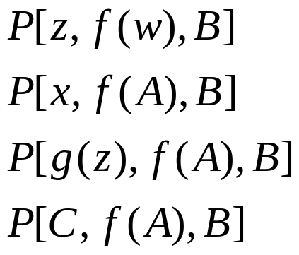
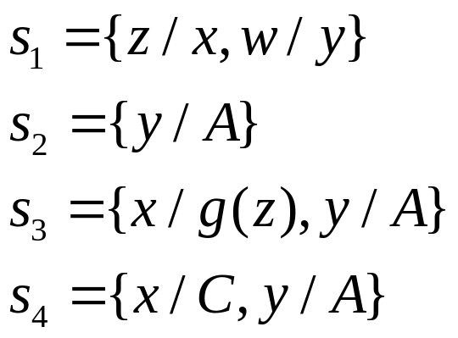

Unification

Slide 14
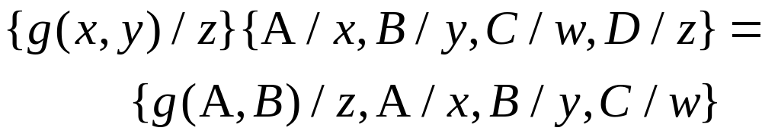
Unification
  The composition s1 and s2 is denoted by s1 s2, which is that substitution obtained by first applying s2 to the terms of s1 and then adding any pairs of s2 having variables not occurring among the variables of s1. Thus,

Slide 15
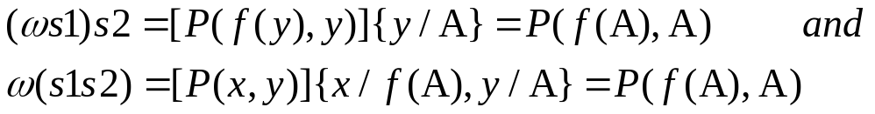
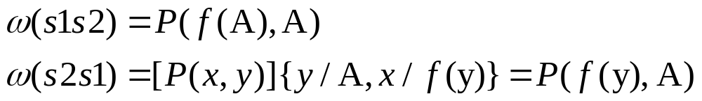



Unification
  Let w be P(x,y), s1 be {x/f(y)}, and s2 be {y/A} then,
  Substitutions are not, in general, commutative
Unifiable: a set of expressions is unifiable if there exists a substitution s such that
  , to yield

Slide 16
Outline
Reducing first-order inference to propositional inference
Unification
Generalized Modus Ponens
Forward chaining
Backward chaining
Resolution

Slide 17
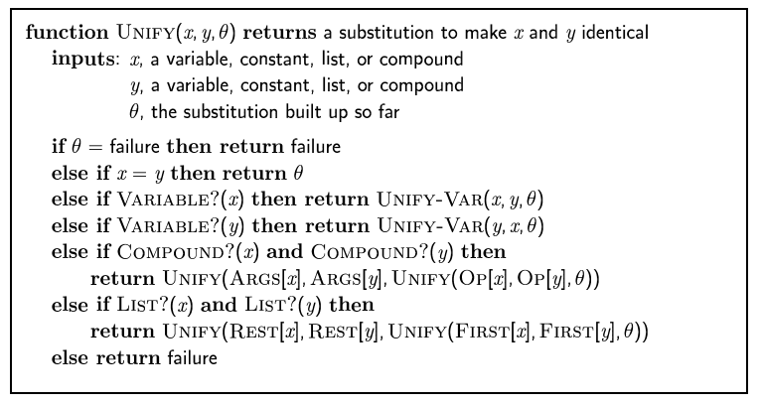
The unification algorithm

Slide 18
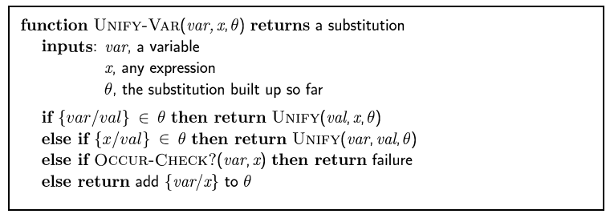
The unification algorithm

Slide 19
Generalized Modus Ponens (GMP)
p₁', p₂', … , p_{n}', ( p₁ ∧ p₂ ∧ … ∧ p_{n} ⇒q)
qθ
p₁' is King(John) ; p₂' is Greedy(y)
P₁ is King(x); p₂ is Greedy(x) ; q is Evil(x)
Substitution θ is {x/John,y/John}
qθ is Evil(John)
GMP used with KB of definite clauses (exactly one positive literal)
All variables assumed universally quantified
where p_{i}'θ = p_{i} θ for all i

Slide 20
Soundness of GMP
Need to show that
p₁', …, p_{n}', (p₁ ∧ … ∧ p_{n} ⇒ q) ╞ qθ
provided that p_{i}'θ = p_{i}θ for all I
Lemma: For any sentence p, we have p ╞ pθ by UI
  (p₁ ∧ … ∧ p_{n} ⇒ q) ╞
  (p₁ ∧ … ∧ p_{n} ⇒ q)θ = (p₁θ ∧ … ∧ p_{n}θ ⇒ qθ)
  p₁ ‘, …, p_{n}' ╞ p₁' ∧ … ∧ p_{n}' ╞ p₁'θ ∧ … ∧ p_{n}'θ
  From 1 and 2, qθ follows by ordinary Modus Ponens

Slide 21
Example: knowledge base
The law says that it is a crime for an American to sell weapons to hostile nations.
The country Nono, an enemy of America, has some missiles, and all of its missiles were sold to it by Colonel West, who is American.
Prove that Col. West is a criminal

Slide 22
Example knowledge base contd.
... it is a crime for an American to sell weapons to hostile nations:
  American(x) ∧ Weapon(y) ∧ Sells(x,y,z) ∧ Hostile(z) ⇒ Criminal(x)
Nono … has some missiles, i.e., ∃x Owns(Nono,x) ∧ Missile(x):
  Owns(Nono,M₁) and Missile(M₁)
… all of its missiles were sold to it by Colonel West
  Missile(x) ∧ Owns(Nono,x) ⇒ Sells(West,x,Nono)
Missiles are weapons:
  Missile(x) ⇒ Weapon(x)
An enemy of America counts as "hostile“:
  Enemy(x,America) ⇒ Hostile(x)
West, who is American …
  American(West)
The country Nono, an enemy of America …
  Enemy(Nono,America)

Slide 23
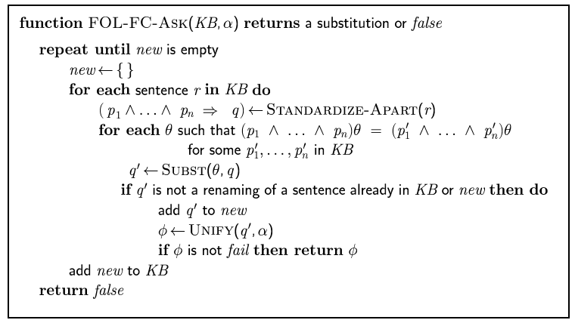
Forward chaining algorithm

Slide 24
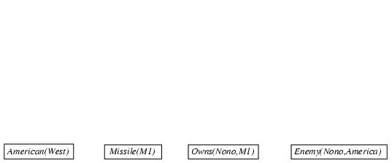
Forward chaining proof

Slide 25
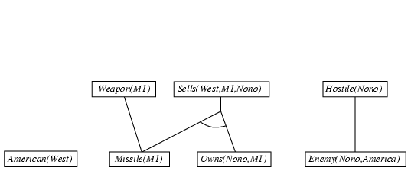
Forward chaining proof

Slide 26
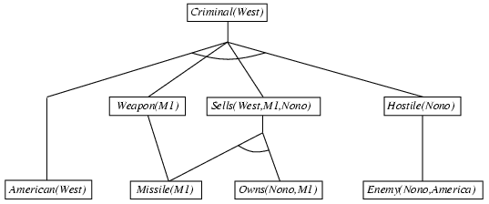
Forward chaining proof

Slide 27
Properties of forward chaining
Sound and complete for first-order definite clauses
Datalog = first-order definite clauses + no functions
FC terminates for Datalog in finite number of iterations
May not terminate in general if α is not entailed
This is unavoidable: entailment with definite clauses is semidecidable

Slide 28
Efficiency of forward chaining
Matching rules against Known facts
  We can remind ourselves that most rules in real-world knowledge bases are small and simple, conjunct ordering
  We can consider subclasses of rules for which matching is efficient, most constrained variable
  We can work hard to eliminate redundant rule matching attempts in the forward chaining algorithm, which is the subject of the next section
Incremental forward chaining: no need to match a rule on iteration k if a premise wasn't added on iteration k-1
  match each rule whose premise contains a newly added positive literal
Matching itself can be expensive:
  Database indexing allows O(1) retrieval of known facts
Forward chaining is widely used in deductive databases
  e.g., query Missile(x) retrieves Missile(M1)

Slide 29

Hard matching example
Diff(wa,nt) ∧ Diff(wa,sa) ∧ Diff(nt,q) ∧ Diff(nt,sa) ∧ Diff(q,nsw) ∧ Diff(q,sa) ∧ Diff(nsw,v) ∧ Diff(nsw,sa) ∧ Diff(v,sa)
⇒ Colorable()
Diff(Red,Blue) Diff (Red,Green) Diff(Green,Red) Diff(Green,Blue) Diff(Blue,Red) Diff(Blue,Green)
Colorable() is inferred iff the CSP has a solution
CSPs include 3SAT as a special case, hence matching is NP-hard

Slide 30
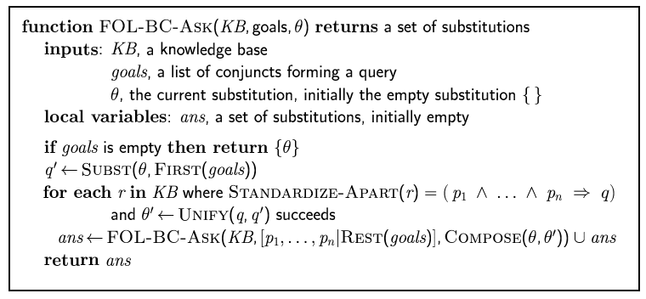
Backward chaining algorithm
SUBST(COMPOSE(θ₁, θ₂), p) = SUBST(θ₂, SUBST(θ₁, p))

Slide 31

Backward chaining example

Slide 32
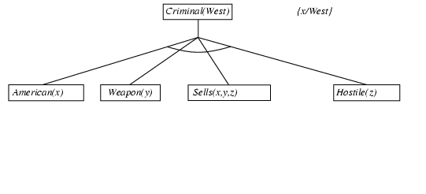
Backward chaining example

Slide 33
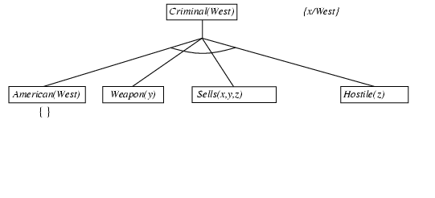
Backward chaining example

Slide 34
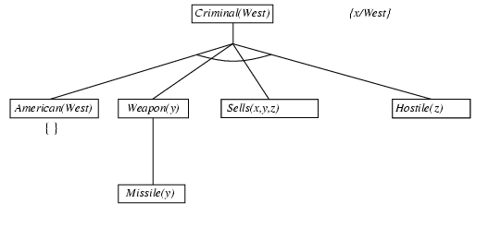
Backward chaining example

Slide 35
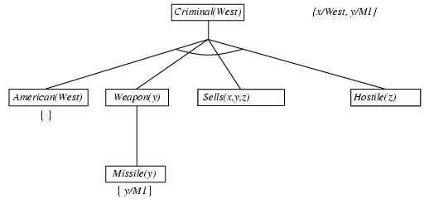
Backward chaining example

Slide 36
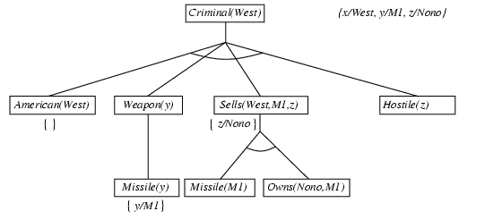
Backward chaining example

Slide 37
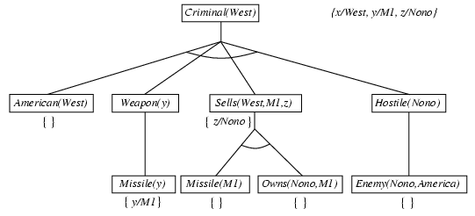
Backward chaining example

Slide 38
Backward chaining example

Slide 39
Properties of backward chaining
Depth-first recursive proof search: space is linear in size of proof
Incomplete due to infinite loops
  ⇒ fix by checking current goal against every goal on stack
Inefficient due to repeated subgoals (both success and failure)
  ⇒ fix using caching of previous results (extra space)
Widely used for logic programming

Slide 40
Logic programming: Prolog
Algorithm = Logic + Control
Basis: backward chaining with Horn clauses + bells & whistles
Widely used in Europe, Japan (basis of 5th Generation project)
Compilation techniques ⇒ 60 million LIPS
Program = set of clauses = head :- literal₁, … literal_{n}.
criminal(X) :- american(X), weapon(Y), sells(X,Y,Z), hostile(Z).
Depth-first, left-to-right backward chaining
Built-in predicates for arithmetic etc., e.g., X is Y*Z+3
Built-in predicates that have side effects
  (e.g., input and output predicates, assert/retract predicates)
Closed-world assumption ("negation as failure")
  e.g., given alive(X) :- not dead(X).
  alive(joe) succeeds if dead(joe) fails

Slide 41
Prolog
Appending two lists to produce a third:
append([],Y,Y).
append([X|L],Y,[X|Z]) :- append(L,Y,Z).
query: append(A,B,[1,2]) ?
answers: A=[] B=[1,2]
A=[1] B=[2]
A=[1,2] B=[]

Slide 42
Resolution: brief summary
Full first-order version:
l₁ ∨ ··· ∨ l_{k}, m₁ ∨ ··· ∨ m_{n}
(l₂ ∨ ··· ∨ l_{k} ∨ m₂ ∨ ··· ∨ m_{n})θ
where Unify(l_{i}, ¬m_{j}) = θ.
The two clauses are assumed to be standardized apart so that they share no variables.
For example,
¬Rich(x) ∨ Unhappy(x) Rich(Ken)
Unhappy(Ken)
with θ = {x/Ken}
Apply resolution steps to CNF(KB ∧ ¬α); complete for FOL

Slide 43
Conversion to CNF
Everyone who loves all animals is loved by someone:
  ∀x [∀y Animal(y) ⇒ Loves(x,y)] ⇒ [∃y Loves(y,x)]
Eliminate biconditionals and implications
Move ¬ inwards: ¬∀x p ≡ ∃x ¬p, ¬ ∃x p ≡ ∀x ¬p
  ∀x [∃y ¬¬Animal(y) ∧ ¬Loves(x,y)] ∨ [∃y Loves(y,x)]
  ∀x [∃y Animal(y) ∧ ¬Loves(x,y)] ∨ [∃y Loves(y,x)]
x [y ➢(➢Animal(y)  Loves(x,y))]  [y Loves(y,x)]
x [➢y ➢Animal(y)  Loves(x,y)]  [y Loves(y,x)]

Slide 44
Conversion to CNF contd.
Standardize variables: each quantifier should use a different one
  ∀x [∃y Animal(y) ∧ ¬Loves(x,y)] ∨ [∃z Loves(z,x)]
Skolemize: a more general form of existential instantiation.
  Each existential variable is replaced by a Skolem function of the enclosing universally quantified variables:
  ∀x [Animal(F(x)) ∧ ¬Loves(x,F(x))] ∨ Loves(G(x),x)
Drop universal quantifiers:
  [Animal(F(x)) ∧ ¬Loves(x,F(x))] ∨ Loves(G(x),x)
Distribute ∨ over ∧ :
  [Animal(F(x)) ∨ Loves(G(x),x)] ∧ [¬Loves(x,F(x)) ∨ Loves(G(x),x)]

Slide 45
Example knowledge base contd.
... it is a crime for an American to sell weapons to hostile nations:
  American(x) ∧ Weapon(y) ∧ Sells(x,y,z) ∧ Hostile(z) ⇒ Criminal(x)
Nono … has some missiles, i.e., ∃x Owns(Nono,x) ∧ Missile(x):
  Owns(Nono,M₁) and Missile(M₁)
… all of its missiles were sold to it by Colonel West
  Missile(x) ∧ Owns(Nono,x) ⇒ Sells(West,x,Nono)
Missiles are weapons:
  Missile(x) ⇒ Weapon(x)
An enemy of America counts as "hostile“:
  Enemy(x,America) ⇒ Hostile(x)
West, who is American …
  American(West)
The country Nono, an enemy of America …
  Enemy(Nono,America)

Slide 46
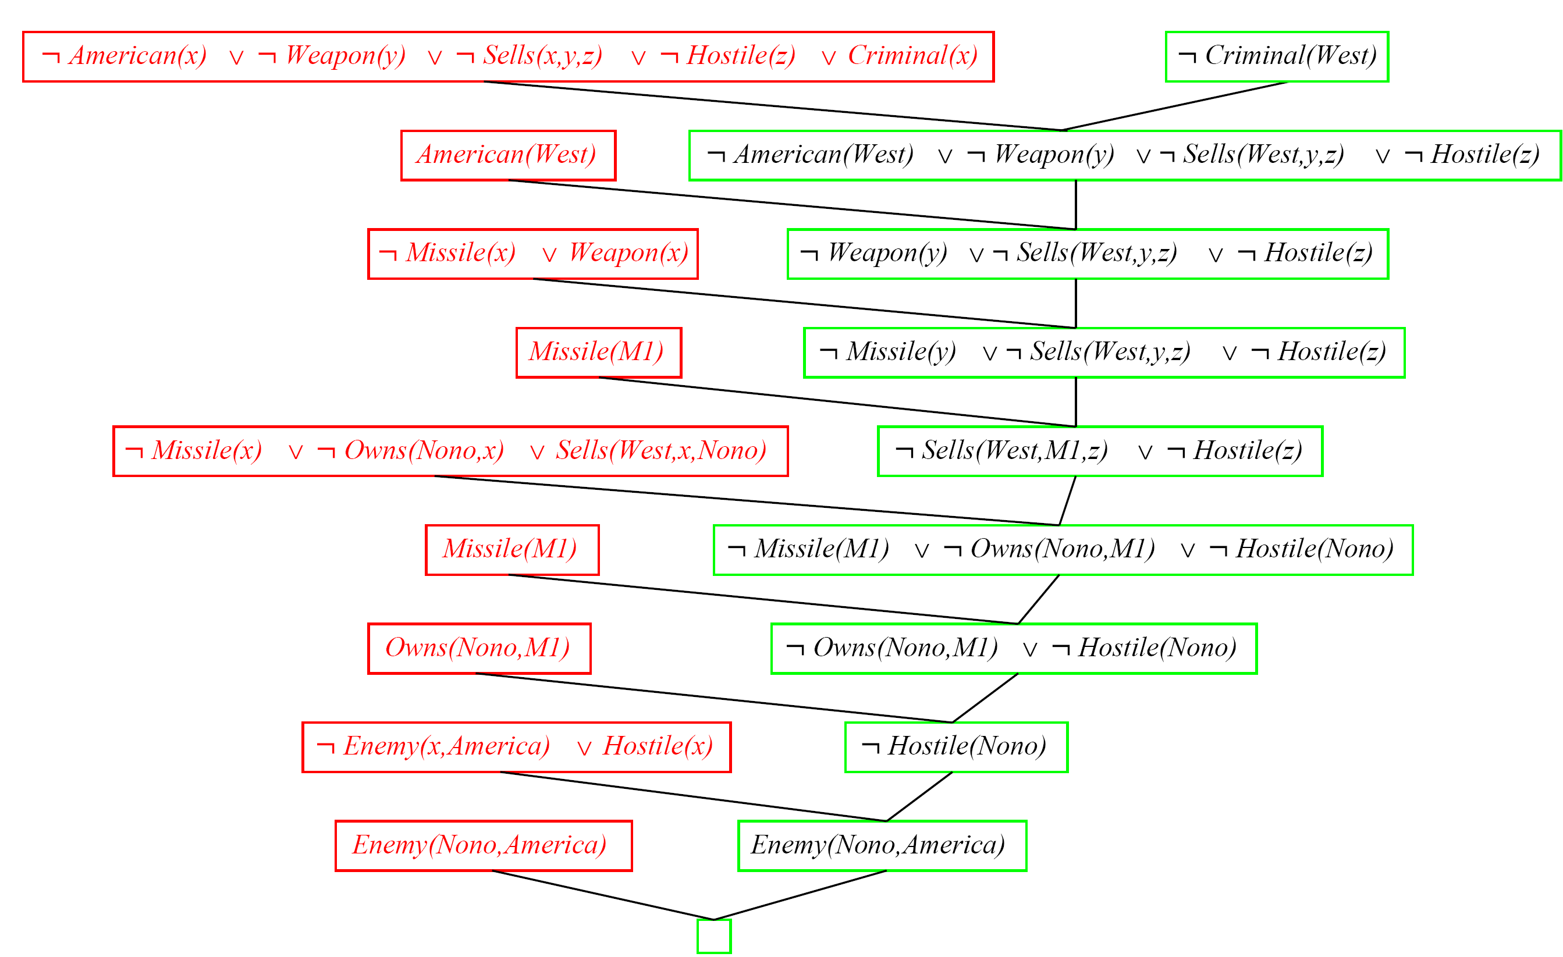
Resolution proof: definite clauses

Slide 47
Refinement Strategies
Set of support strategy
  Allows only those resolutions in which one of the clauses being resolved is in the set of support, i.e., those clauses that are either clauses coming from the negation of the theorem to be proved or descendants of those clauses.
  Refutation complete
Linear input strategy
  at least one of the clauses being resolved is a member of the original set of clauses.
  Not refutation complete
Ancestry filtering strategy
  at least one member of the clauses being resolved either is a member of the original set of clauses or is an ancestor of the other clause being resolved.
  Refutation complete

Slide 48
Simple Example
Sam, Clyde and Oscar are elephants. We know the following facts about them:
  Sam is pink.
  Clyde is gray and likes Oscar.
  Oscar is either pink or gray(but not both) and likes Sam
Prove a gray elephant likes a pink elephant.

Slide 49

Given the following facts：
Pink(A);
Gray(B);
Gray(C ) ∨ Pink(C );
¬ Gray(C ) ∨¬ Pink(C );
Likes(B,C);
Likes(C,A);
To prove (∃ x,y) [ Gray(x) ∧Pink(y) ∧ Likes(x,y)]

Slide 50
Exercise
，
P1:
P2:
Prove P1 ╞ P2 by resolution

